Slide 1
CIFAR-10 Object Recognition in images
TEAM VISION
Mayank Dhingra (013773942)
Mohit Gahlot (013753454)
Tina Aggarwal (013735592)
Richita Das (013759746)

Slide 2
Dataset:
The CIFAR-10 dataset (Canadian Institute For Advanced Research) is a collection of images that are commonly used to train machine learning and computer vision algorithms. Computer algorithms for recognizing objects in photos often learn by example. CIFAR-10 is a set of images that can be used to teach a computer how to recognize objects.
60000 32 x 32 color images in 10 classes
Training set - 50000 images
Test set - 10000 images
The label classes in the dataset are: airplane, car, bird, cat, deer, dog, frog, horse, ship, truck. Each class contains 6000 images.
The dataset images are in pickled format

Slide 3
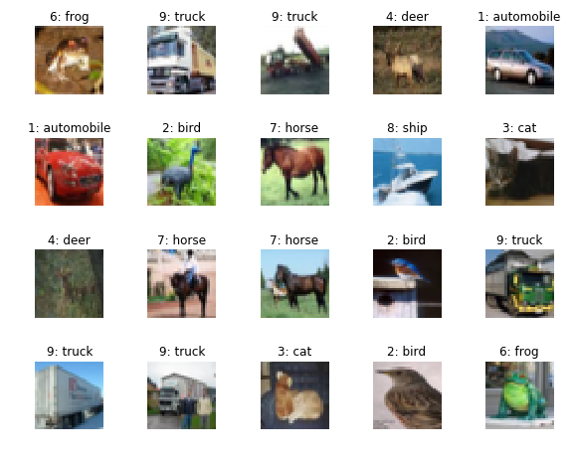
The images in the CIFAR-10 dataset are in low resolution(32 X 32)

Slide 4
Preprocessing
Pickling is a way to convert a python object (list, dict, etc.) into a character stream. The idea is that this character stream contains all the information necessary to reconstruct the object in another python script.
Unpickled data
Images - 32 X 32 X 3
Reshaped the data after unpickling in this format. The 3 symbolizes the RGB layers.
One - hot encoding : Most machine learning algorithms require numerical input and output variables. One hot encoding is used to convert categorical data to integer data.
The image labels for train and test date were one-hot encoded.
Batches of 100 images to prevent kernel shutdown.

Slide 5
MODELS
Histogram of Oriented Gradients
Convolution Neural Network
YOLO

Slide 6
HOG
Reshaped the dataset to 32X32X3
Feature Extraction using HOG
PCA(Principal Component Analysis)
SVM
F1 Score - 0.09

Slide 7
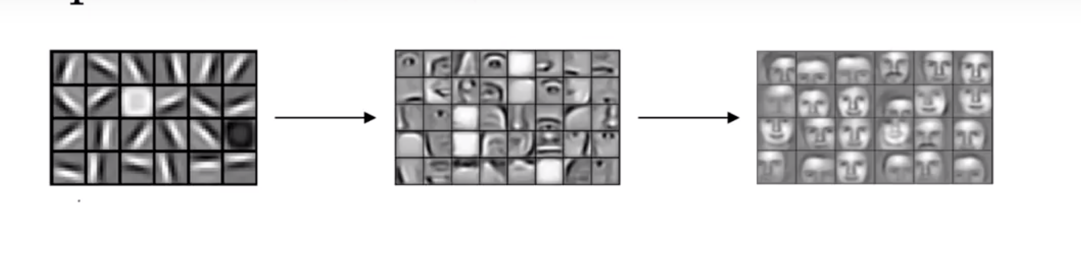
Convolutional Neural Network
Convolutional Layer : The convolutional layer is the core building block of a CNN. The layer's parameters consist of a set of learnable filters (or kernels), which have a small receptive field, but extend through the full depth of the input volume.

Slide 8
Weights, Bias : Learning in a neural network progresses by making incremental adjustments to the biases and weights and finding the right combination of these.
Max pooling : Pooling layers reduce the dimensions of the data by combining the outputs of neuron clusters at one layer into a single neuron in the next layer. Here we have used max pooling. Max pooling uses the maximum value from each of a cluster of neurons at the prior layer.
Fully connected layer : Fully connected layers connect every neuron in one layer to every neuron in another layer.

Slide 9
Project
4 convolution layers and 4 fully connected layers have been used to improve accuracy
Softmax is used to convert the last layer into 10 neurons for the 10 classes we have
AdamOptimizer is used to train the model, minimize the cost function and retrieve optimal weights and bias for better accuracy.
Learning Rate - 0.004 for optimization
Pass batches to session to train and predict so that the kernel does not shutdown.

Slide 10
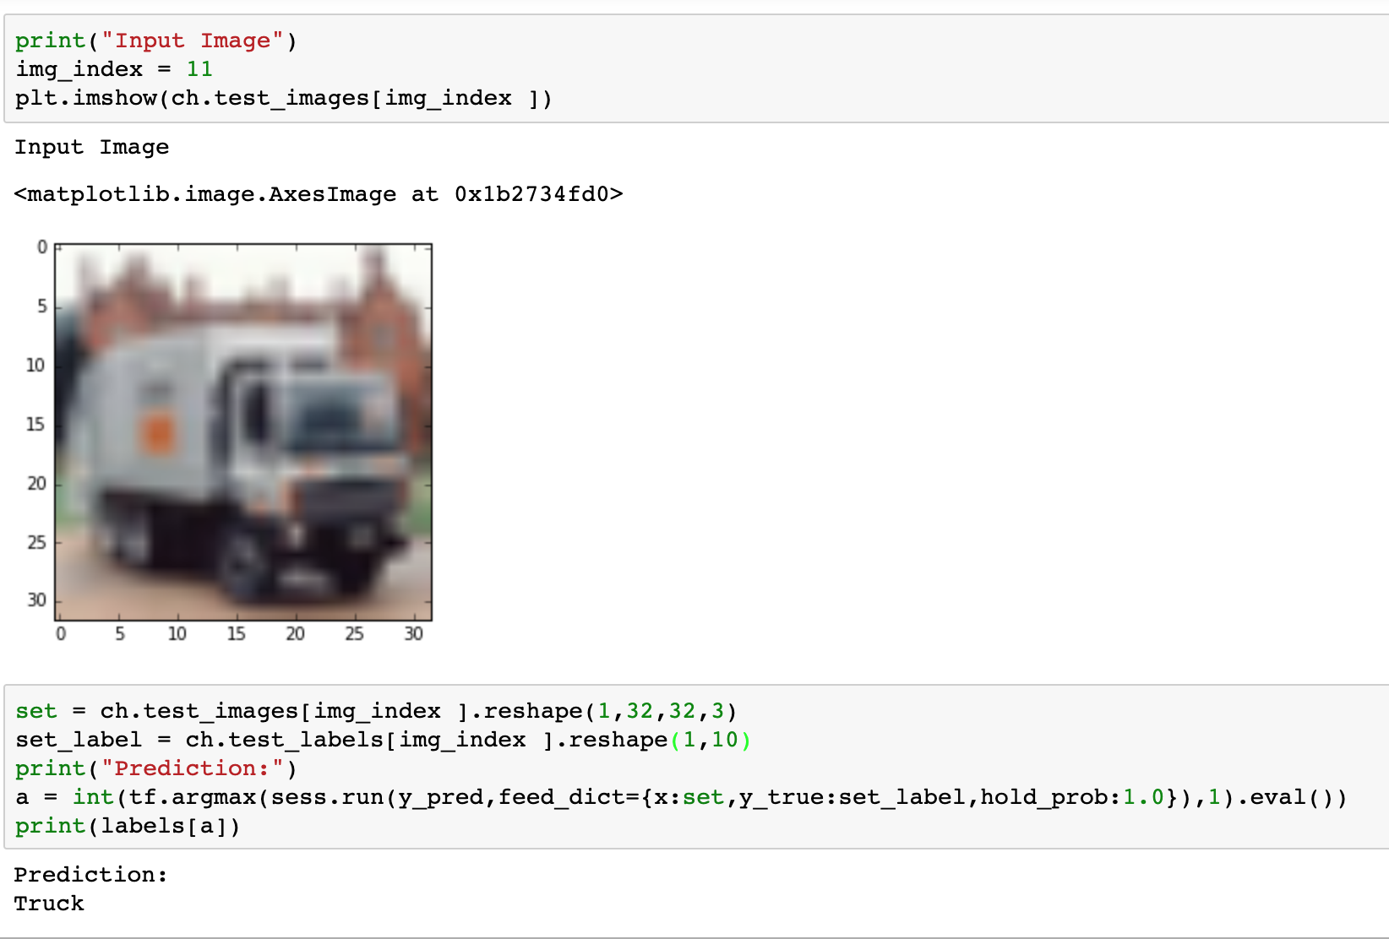
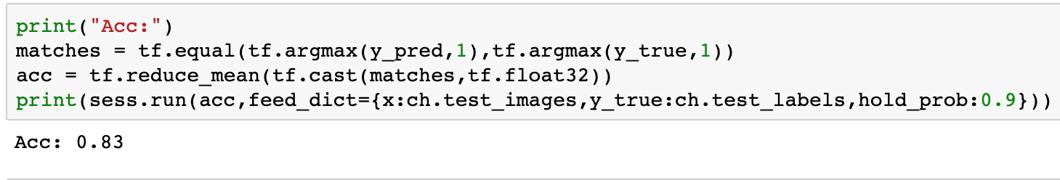
Prediction
Accuracy

Slide 11
YOLO
You only look once :
Breaks the image into smaller grids
Each cell can predict upto 5 bounding boxes
Assigns confidence scores for bounding box and class prediction
Combines the two confidence scores
Higher the final confidence score, thicker the bounding box boundary
9 convolutional layers followed by 6 max pooling layers (FC)
For our project, we are using tiny yolo
We have a confidence score threshold of 16%

Slide 12
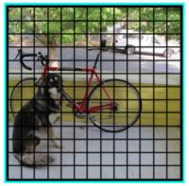

Slide 13
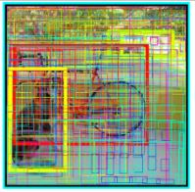

Slide 14
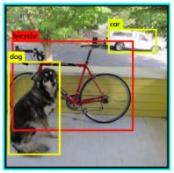

Slide 15
DEMO

